Slide 1
Notes: 1. Correct fonts won’t load until you open this in PowerPoint (e.g., if you’re previewing this in your browser it’ll look uglier than it actually is). 2. Generate QR codes here: https://www.qrcode-monkey.com/

Slide 2
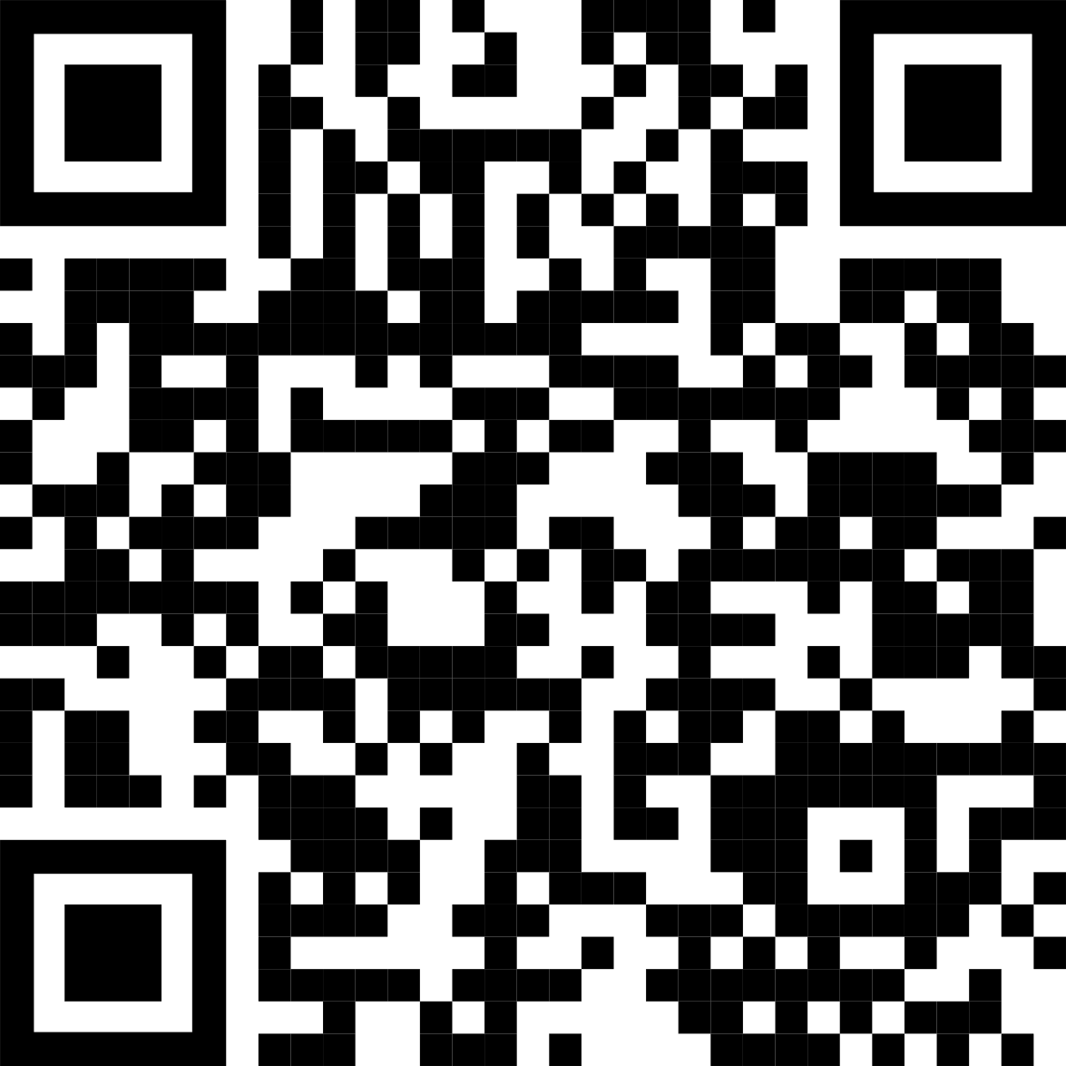
Main finding goes here, translated into plain English. Emphasize the important words.
Non-Cognitive Predictors of Student Success: A Predictive Validity Comparison Between Domestic and International Students
Non-Cognitive Predictors of Student Success: A Predictive Validity Comparison Between Domestic and International Students
Title: Subtitle
AMMO BAR
Delete this and replace it with your…
Extra Graphs
Extra Correlation tables
Extra Figures
Extra nuance that you’re worried about leaving out.
Keep it messy! This section is just for you.
Leeroy Jenkins, author2, author3, author4
INTRO
Just give quick context for the gap you’re filling.
METHODS
N = ###,
Collected this
Tested with X statistical test
RESULTS
Graph or table with essential results only.
All the other correlations in the ammo bar
DISCUSSION
“If this result actually generalized and I didn’t have to humbly disclaim the possibility of a thousand confounds and limitations, it would imply that….”
Keep font size as high above 28+ as possible.
Keep your summary tight. Think of it like “abstract+” with key figures only.
The more content you add here, the more cognitive load you add, and the more you’ll turn people off engaging.
Less content = more readers.
Now delete this text box. ☺
Take a picture to download the full paper
Notes:
Notes:
In Powerpoint, click View > Guides
Keep text within gutter guides.
Author list: Don’t split names onto two lines (e.g., “Jimmy [break] Smith”). If that happens, use a new line, unless you need the space. Bold the first names of anybody who’s presenting in person.
Intro/methods/result: Do not drop below font size 28, but if you have extra space, jack up the font size until the space is full.
Do not use color in the sidebars except in graphs/figures. It’ll pull attention from the center and slow interpretation for passersby.

Slide 3
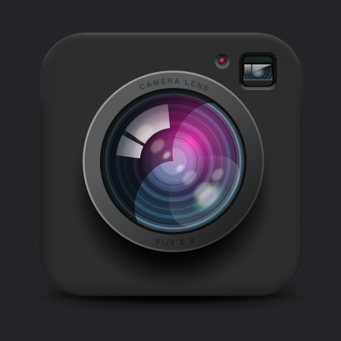
Add Images
Prime & reinforce the topic of your study with accent imagery.

Slide 4
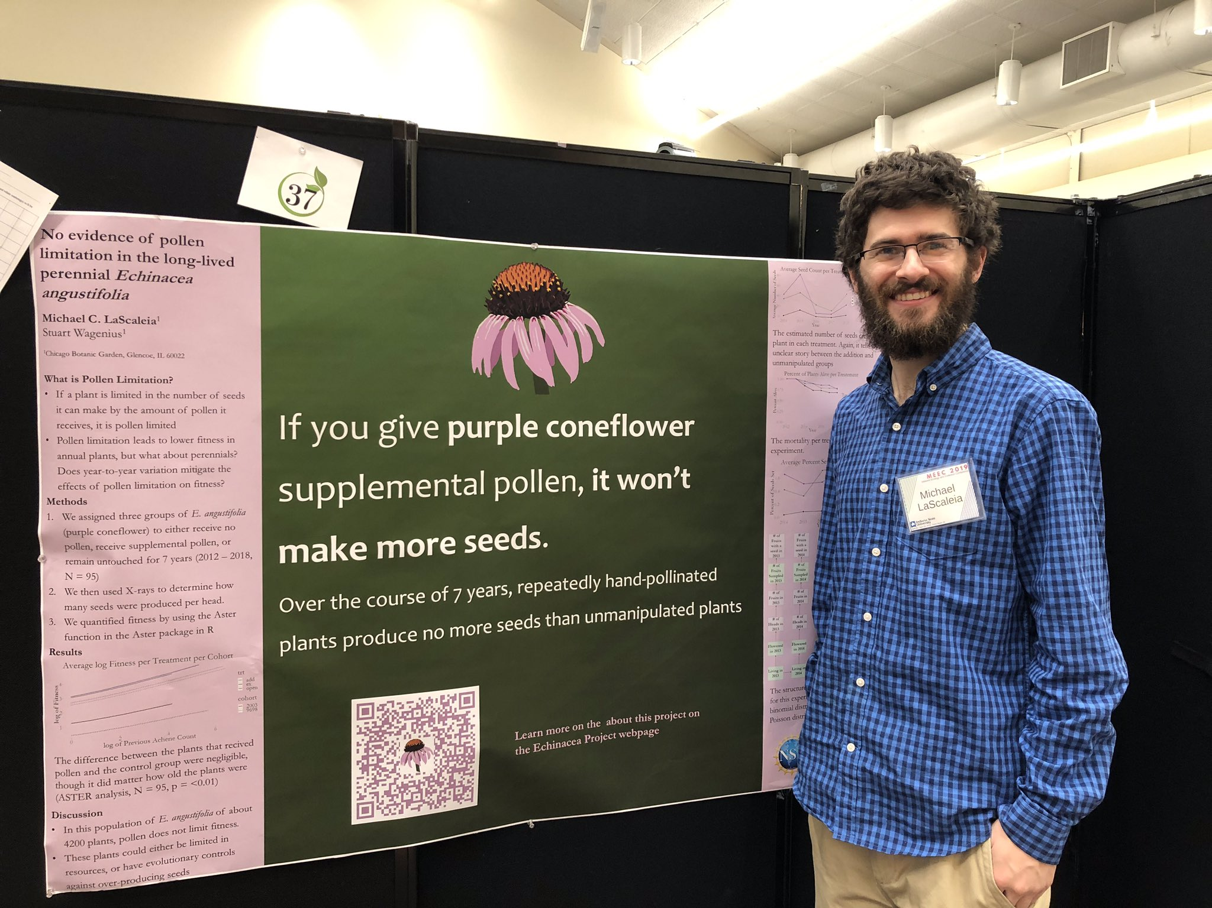
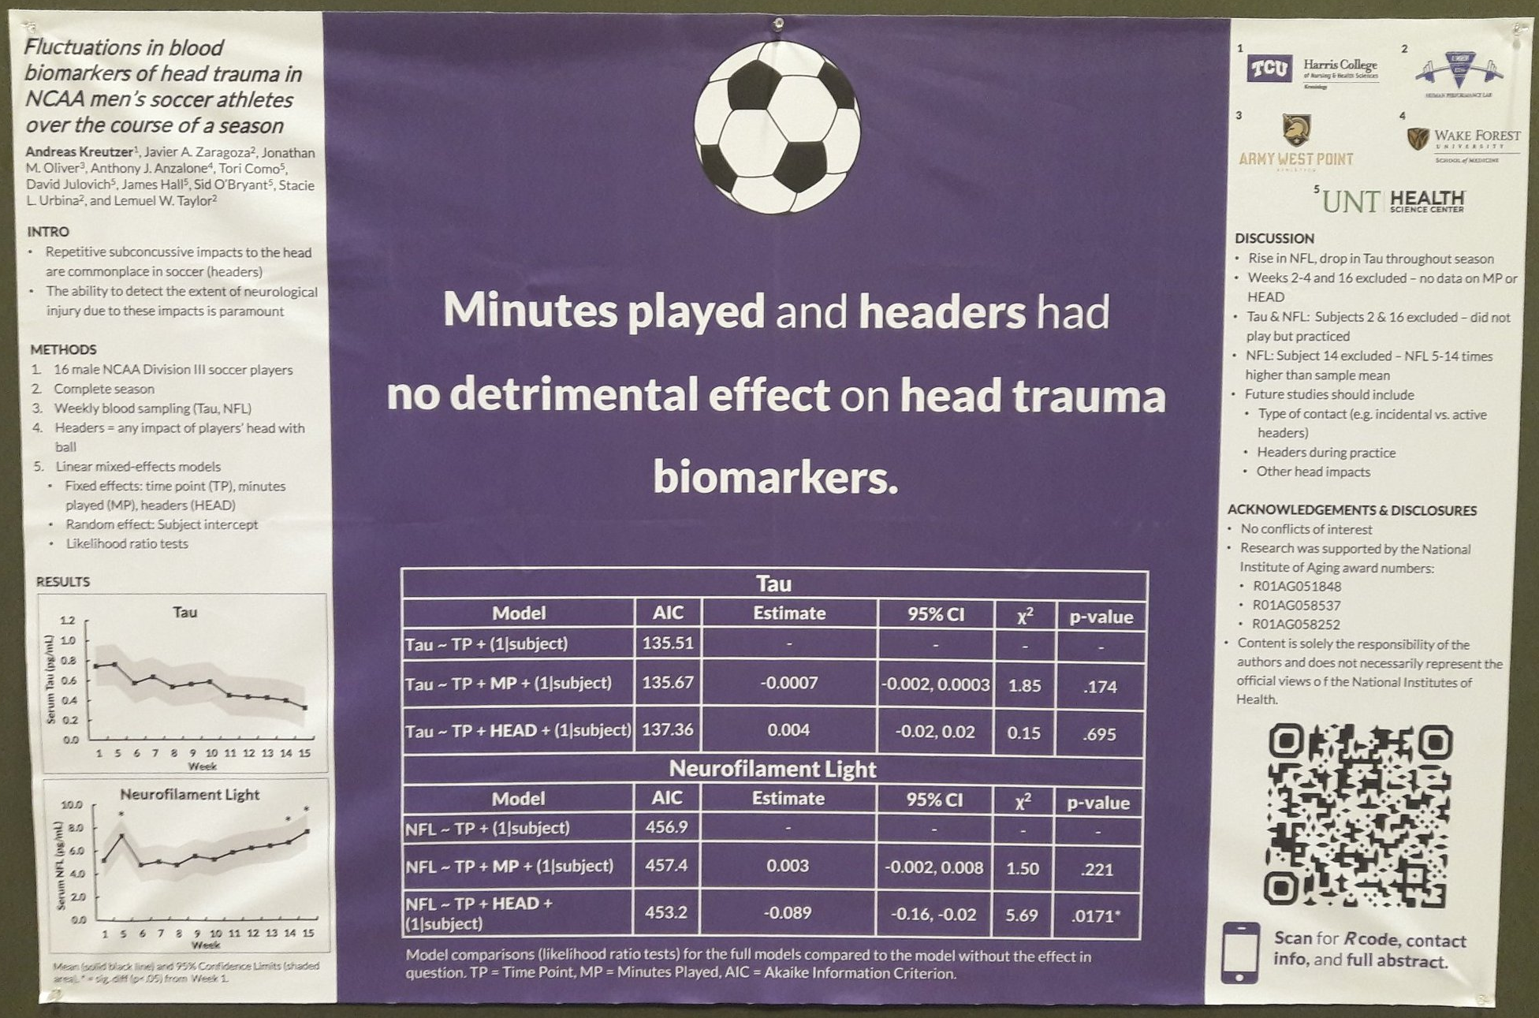
The ‘hat’ icon. Fun, reinforces your finding, makes your poster memorable — and can be interpreted at-a-glance.
Example donated by @MCLaScience
Example donated by @DStroumsa
Example donated by @ElzaRechtman
Example donated by @mikemorrison
Example donated by @akreutzer82

Slide 5
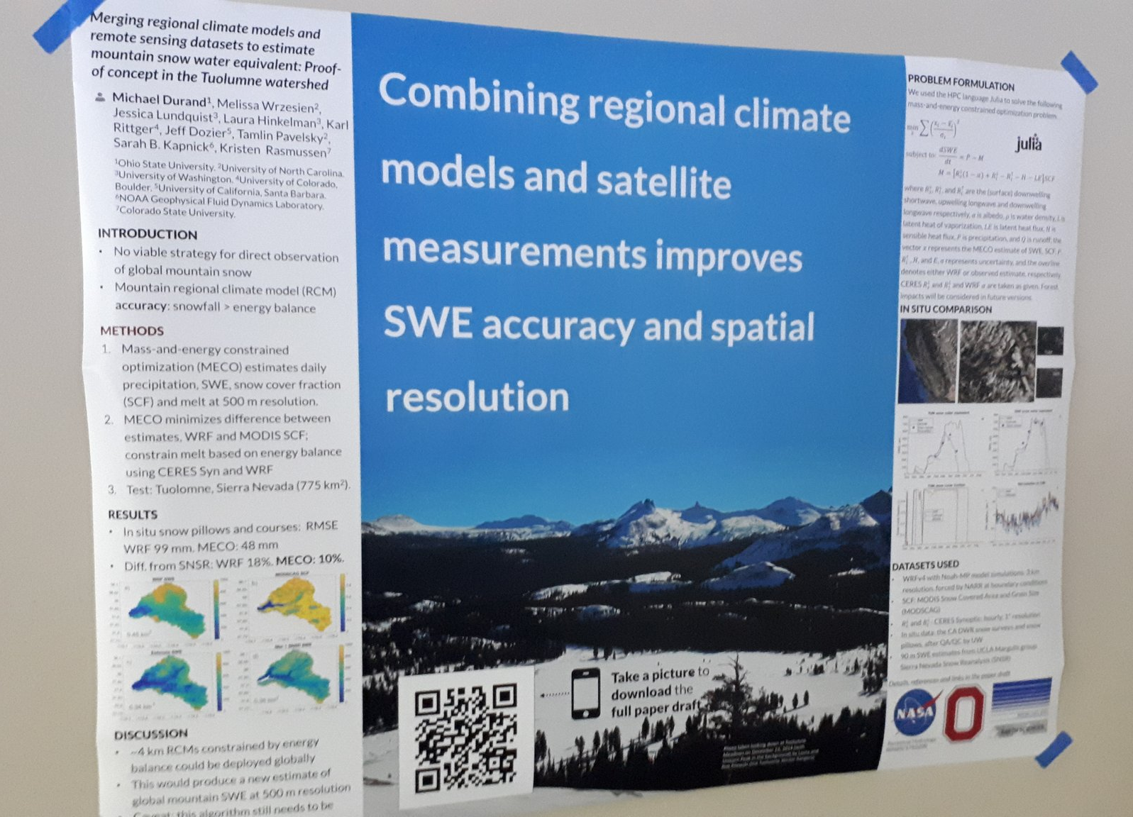
The ‘floor’ accent graphic. The most space-efficient way to add fun and reinforce your theme. Stick your QR right on top!
Example donated by @hydrogawker
Mountain photo by @mnthydro

Slide 6
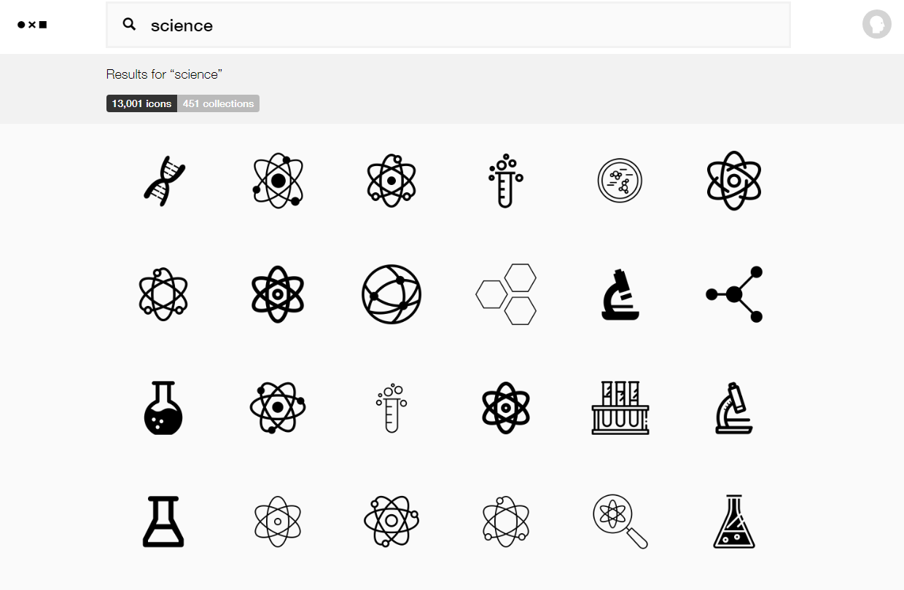
You can get icons from TheNounProject.com
https://thenounproject.com

Slide 7
Get full-color graphics on a transparent background for ~$1/each from…
VectorStock.com
https://vectorstock.com

Slide 8
Gallery
Real posters designed based off of the main templates.

Slide 9
Example donated by @milankloewer
http://www.milank.de/documents/kloewer_egu.pdf

Slide 10
Example by @mikemorrison

Slide 11
Example by @jesshlay

Slide 12
Example donated by @MattKuhnDVM
Example donated by @SPrinceWare

Slide 13
Mods
Community-submitted modifications that you can edit.
Make them your own!

Slide 14
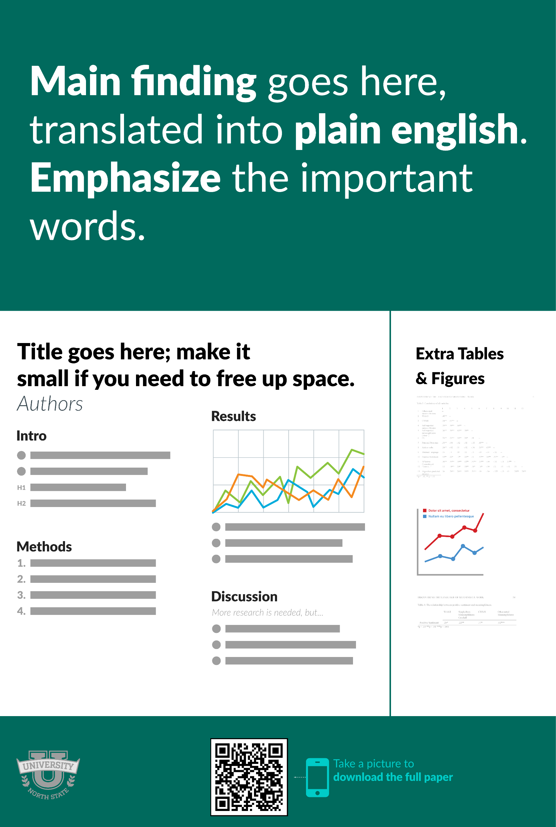
Portrait Orientation https://osf.io/g6xsm/
R/Markdown Template https://t.co/UsW4crrPZO?amp=1
by @mikemorrison
by @brentthorne18
Reproducible (LIVE) HTML poster (e.g., moving GIFs if you're into that)
Printable to PDF
Supports google fonts
Click for full features list…

Slide 15
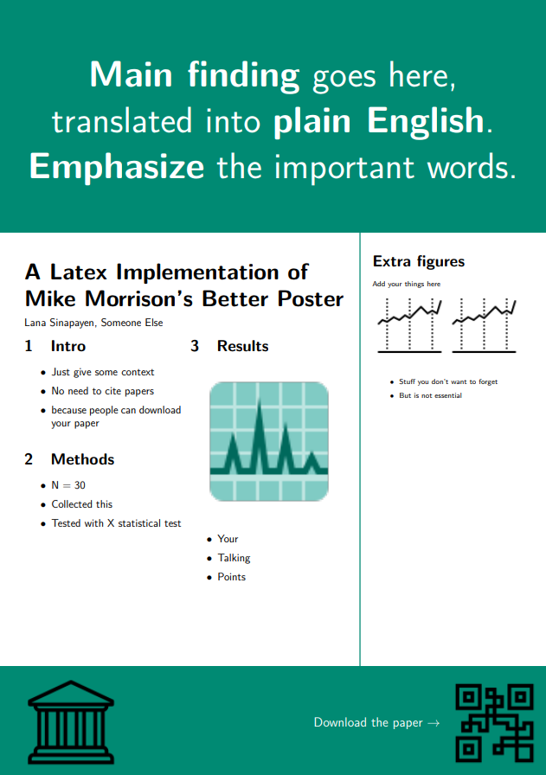
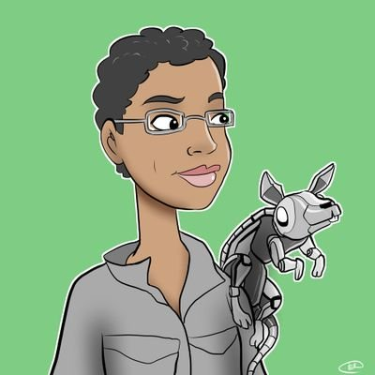
Templates
Portrait
Landscape
by @sina_lana
by @rtsbailo
Download (Ctrl/Cmd + Click)
Download (Ctrl/Cmd + Click)
https://github.com/LanaSina/better_poster_latex
https://www.overleaf.com/latex/templates/better-poster-latex-template/gmkgjvxqbyyt

Slide 16
Translations
v
v
Traditional Chinese
Simplified Chinese
Landscape
https://osf.io/td9sp/
Portrait
https://osf.io/nk8gh/
Landscape
https://osf.io/3dfwa/
Portrait
https://osf.io/n3e8x/

Slide 17
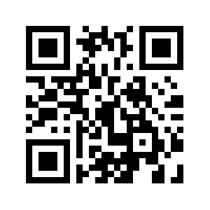
Why must we pick sides? The new poster format is a revolution, or the new poster format is garbage! Take the good parts of the new format, keep the useful aspects of the traditional format, add in your own ideas, and create something better.
We Don’t Have to Pick a Side: The Middle Is A Fine Place to Be
Andrew R. Smith
Appalachian State University
INTRODUCTION
Mike Morrison created a template for a “Better Scientific Poster” (BSP) (https://osf.io/ef53g/)
The BSP format has been praised by many, yet disparaged by others.
The current project had 2 goals:
Create a template that I think could be useful.
Point out that we don’t need to either love or hate the new format—the middle is just fine.
METHOD
To create a new template, I identified strengths of the BSP template and the traditional format.
BSP strengths: clear take-away message, minimal text, QR code
Traditional format strengths: room for figures, reasonable text size on sides, large title to make finding posters in poster session easy, web link and email for people who don’t like QR codes
RESULTS
Preregistered analysis: 78% increase in liking compared to traditional format and 24% increase compared to the BSP format.
Exploratory analysis: room for improvement in this template (Arial font, seriously?!?!).
DISCUSSION
Sometimes it makes sense to pick a side; this is not one of those times.
Praise what you like, make suggestions for improvement, and then make something better.
Take Mike’s ideas, incorporate some of mine, be creative, and let’s make posters more useful.
Poster template: https://osf.io/ayjzg/
smithar3@appstate.edu
Notes:
Notes:
In Powerpoint, click View > Guides
Keep text within gutter guides.
Author list: Don’t split names onto two lines (e.g., “Jimmy [break] Smith”). If that happens, use a new line, unless you need the space. Bold the first names of anybody who’s presenting in person.
Intro/methods/result: Do not drop below font size 28, but if you have extra space, jack up the font size until the space is full.
Do not use color in the sidebars except in graphs/figures. It’ll pull attention from the center and slow interpretation for passersby.

Slide 18
F.A.Q.
Frequently Asked Questions – The closest thing to a users’ manual this will ever have.

Slide 19
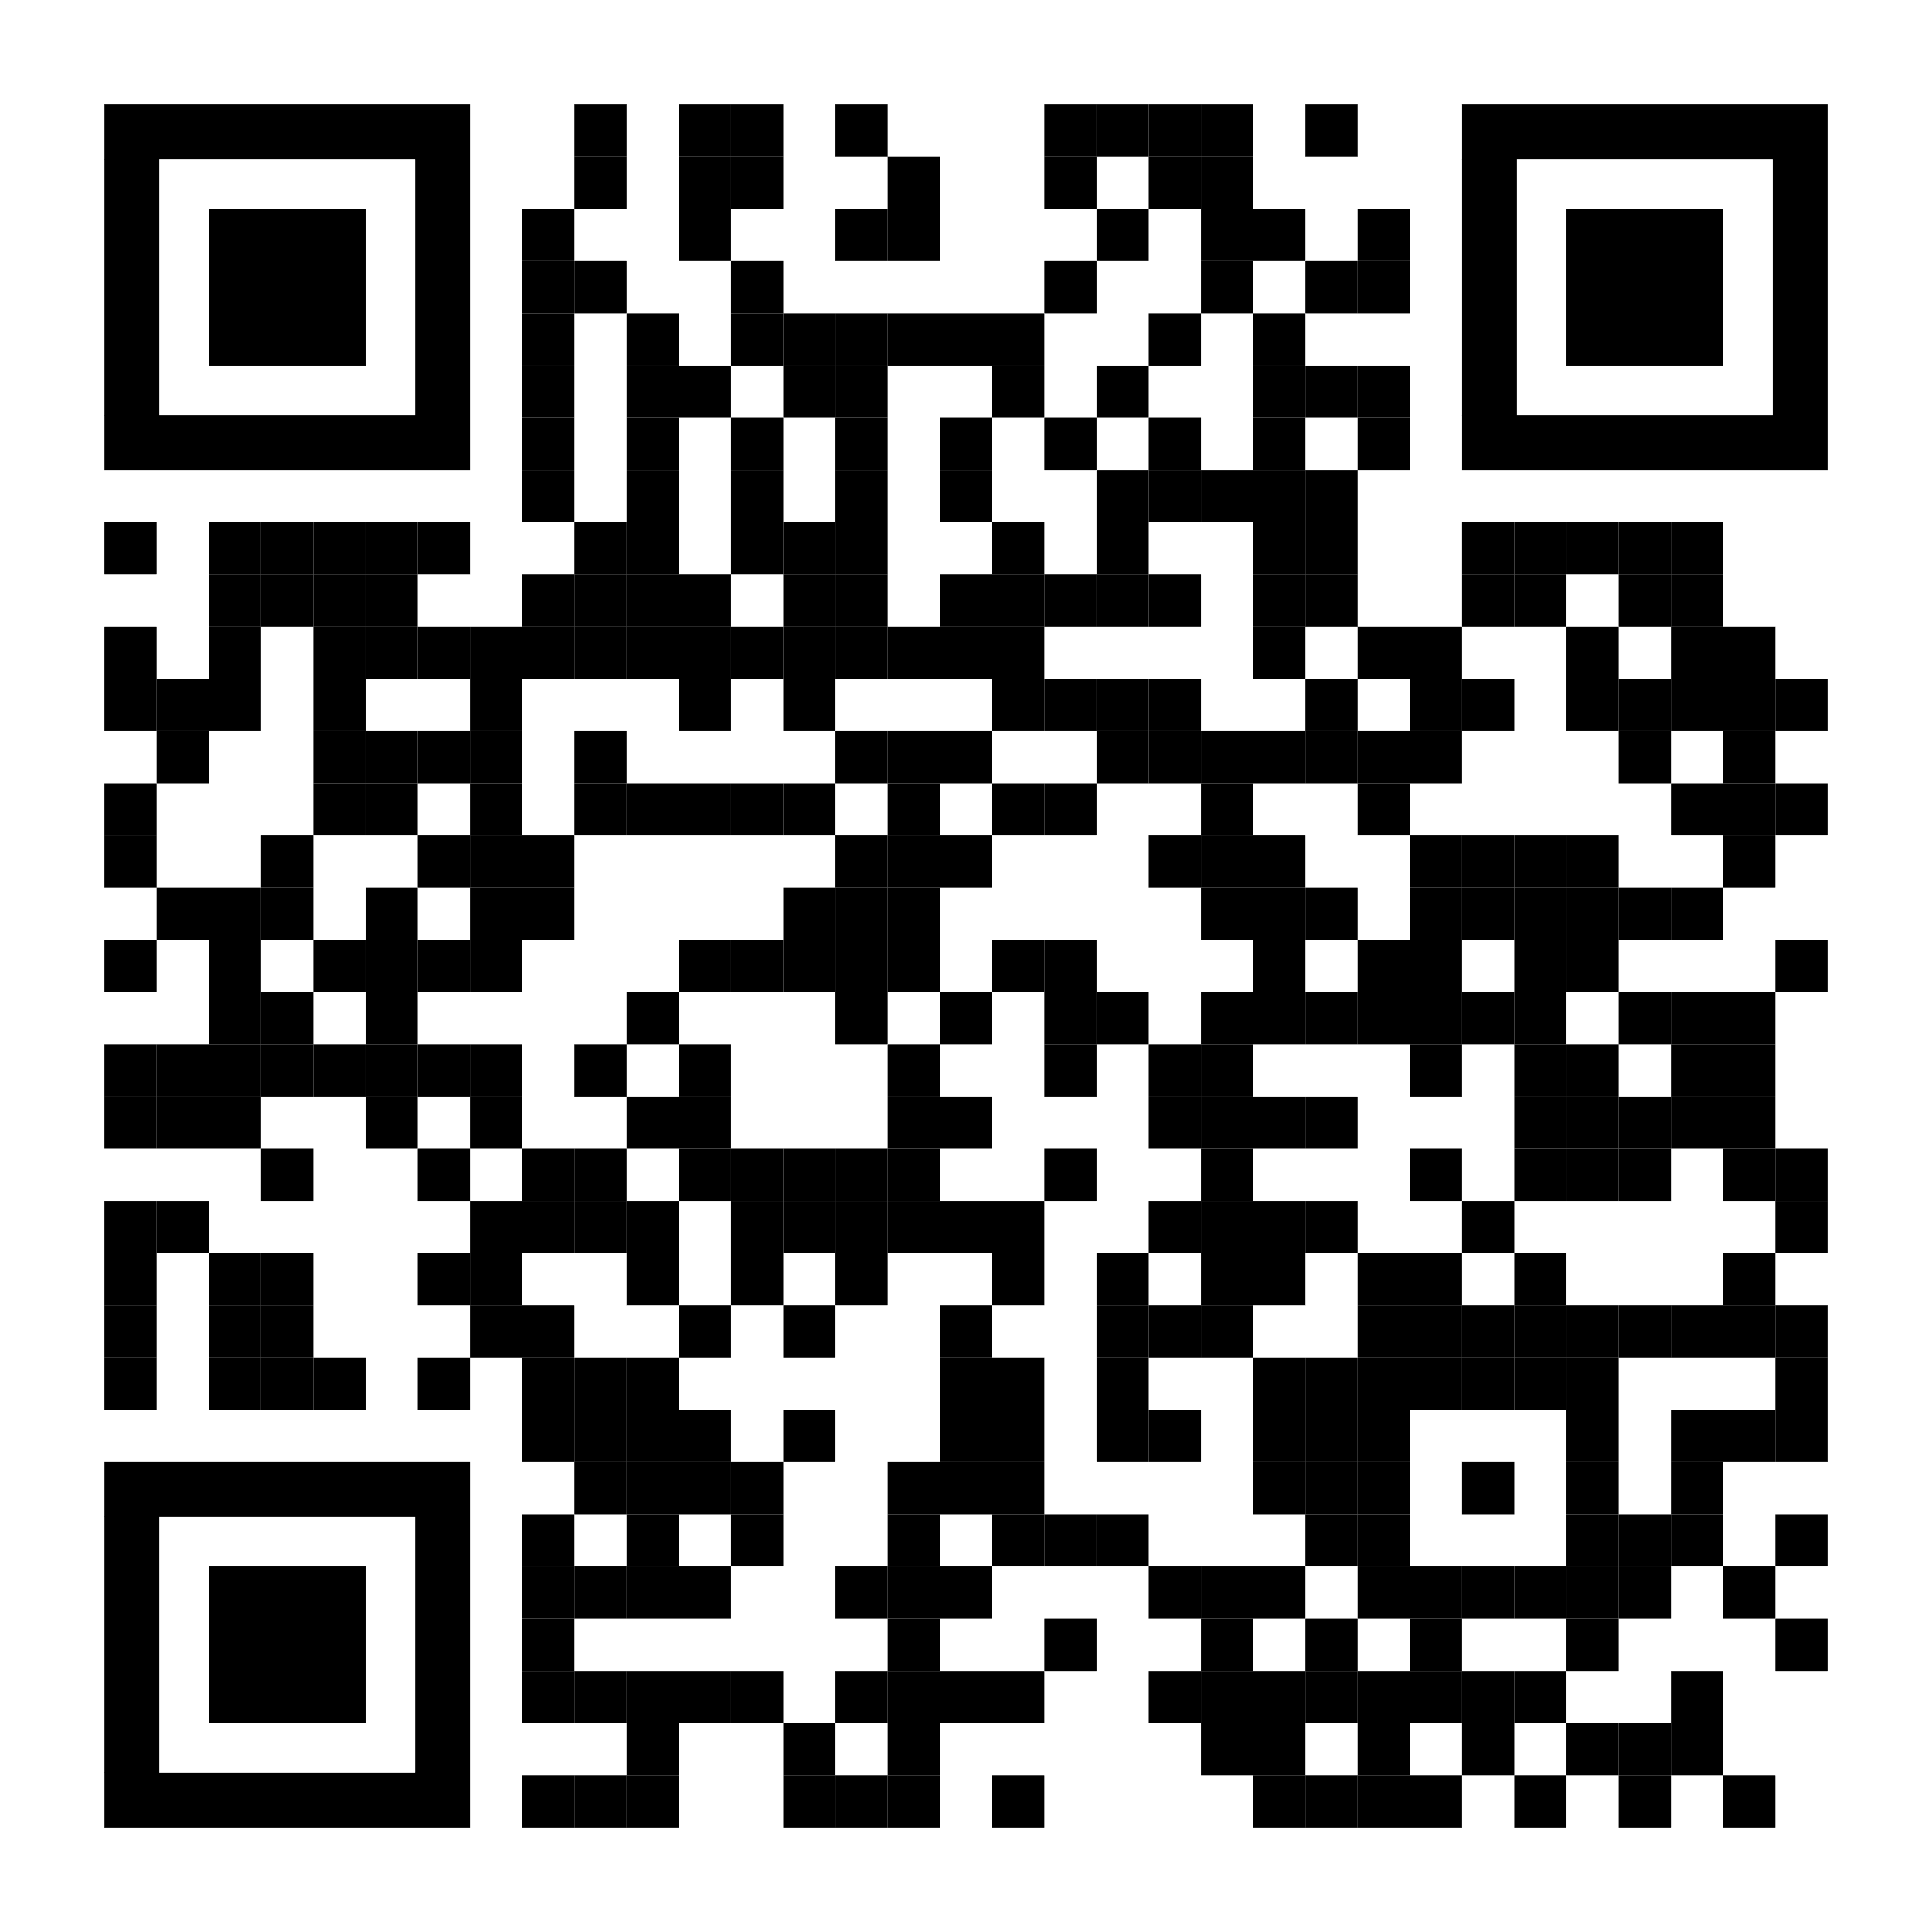
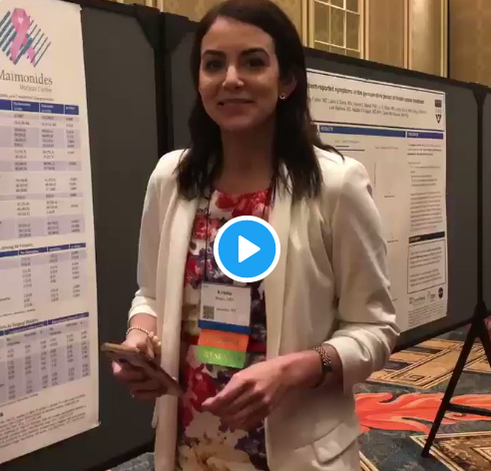
How to QR Code
How do I create a QR code?
https://www.qrcode-monkey.com/ is free, URLs don’t expire, and you can add cool features like images.
How do I scan a QR code?
Just pull out your phone and take a picture! All modern iPhones and most Android phones have built-in QR detection in their cameras. Some Android phones may need an app.
How can I link the QR to my paper and a copy of my poster and my contact details.
Try creating a multi-page link for free via https://linktr.ee/. (Still trying to figure out the best answer to this though.
Ctrl-click this thumbnail to watch a video on scanning #betterposter QR codes.
Donated by @kristinrojasmd
https://twitter.com/kristinrojasmd/status/1124418213050298368

Slide 20
Layout F.A.Q.
What if my intro/methods/results doesn’t fit in the silent bar?
If you’re trying to put so much into that bar that it doesn’t fit, they won’t have time to read it anyway. First try moving stuff to the ammo bar. Next, cut cut cut.
Instead of trying to fill space, you’re trying to conserve space.
What if I have a really important graph or picture?
Move the QR Code to the Silent Presenter, then put your graph/image in the middle.

Slide 21
How did you make the cartoon?
Short version: I highly recommend making a video using Vyond.com if it's your first one and you don't want to go insane for a year like I did. It’s fun, easy, and works perfectly well for most projects.!
Animation: Most of the animation was done in Adobe After Effects, which is super powerful but had a bit of learning curve for me.
Graphics: A combination of VectorStock and custom graphics I made in Adobe Illustrator.
Characters were mostly from (http://Vyond.com) Vyond.com. I got the facial expressions, etc. right in Vyond, then put them on a green background, then dropped them into After Effects and removed the background, just like a green screen.
Sound effects: AudioJungle.
Voice was my own voice with the bass boosted for a little of that radio announcer vibration, courtesy of Adobe Audition.

