Slide 1


Promoting mental health in an age of uncertainty:
A presentation as part of the world cbt day 2023
Presented by: Presenter’s Name
On behalf of: Organization Name/ logo
Contact: Email/ phone
April 7, 2023

Slide 2
outline
Overview of Mental Health and Mental Disorders
Key Considerations in Mental Health
Cognitive Behavior Therapy (CBT) Can Help
Resources
Questions and Discussion

Slide 3
WHAT IS MENTAL HEALTH?
According to the World Health Organization (WHO), mental health is …
“a state of wellbeing in which the individual realises his or her abilities, can cope with the normal stresses of life, work productively and fruitfully, and is able to make a contribution to his or her community'..”
Signs of mental health…
Well- being
Managing difficulties
Working towards goals consistent with personal values
Social connection

Slide 4

POOR MENTAL HEALTH
Mental Health exists on a continuum. There are various signs of declining or poor mental health.
Poor mental health can often be resolved through engaging in positive coping strategies and self-care, and through accessing resources
Trouble sleeping or eating
Difficulty concentrating and focusing
Feeling “moody” or irritable
Inability to cope with stressors
Almost everyone experiences poor mental health during their lifetime!

Slide 5
MENTAL DISORDERS
There are a range of mental disorders – they affect the emotional, psychological, and physical well- being of an individual, marked by disturbances in thoughts, feelings, and perceptions that are severe enough to affect day-to-day functioning.
Mental disorders are diagnosed by mental health professionals.
Mental disorders are most often temporary, and best be treated as quickly as possible, and with a proven treatment model.

Slide 6
THE MENTAL HEALTH CONTINUUM
The Mental Health Continuum Model implies a range of possible mental health states, from healthy to ill, and marked by a range of signs or symptoms, as shown on the next slide.

Slide 7
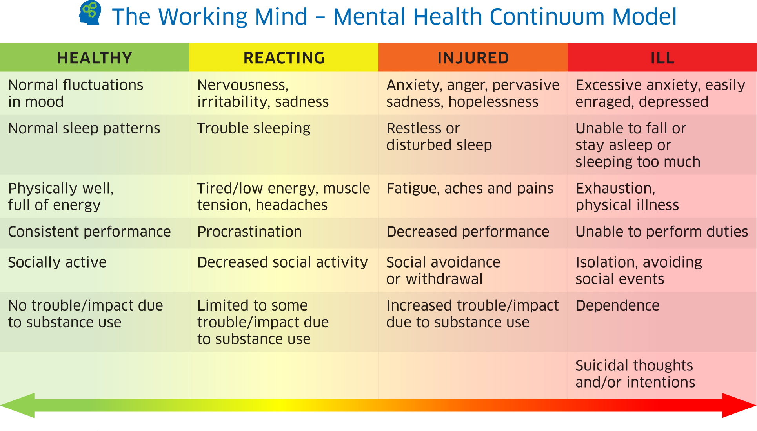
THE MENTAL HEALTH CONTINUUM MODEL

Slide 8
RISK AND RESILIENCE FACTORS
The WHO notes that there is no single factor that can explain the occurrence of mental health problems; rather, it is the interaction of many different factors, some of which increase risk and others that foster resilience.
Biological, psychological and social/ environmental factors work together to foster mental health, or to lead to challenges or even to trigger a mental disorders. This approach is called the biopsychosocial model of illness.
People are integrated biopsychosocial entities, and need to be treated in a holistic manner.

Slide 9
THE BIOPSYCHOSOCIAL MODEL
Psychological
Attitudes/ beliefs
Low self-esteem
Negative thinking
Helplessness
Poor coping skills
Biological
Genetic risk
Biochemistry
Physical dysregulation
(e.g. sleep, diet)
Substances and Drugs
Social
Past Trauma
Family Issues
Lack of social support
Negative life events
Cultural beliefs
Mental Health Problems

Slide 10
Living in a stressful world
Life involves stress. WHO Defines stress as “any type of change that causes physical, emotional or psychological strain”
The three major factors associated with stress are:
  Unpredictability- not knowing what might happen
  Uncontrollability- not knowing how to cope or manage a stressful event
  High importance- events of high personal value, such as threat to life, family, lifestyle

Slide 11
COPING STRATEGIES
Fortunately, most people manage most of their stressors most of the time
No single strategy works for every situation or person
People usually rely on a few “tried and true” coping strategies
Problem-focused coping tackles stressful situations directly; is generally recommended over avoidance or emotion- focused coping

Slide 12
Cognitive behavioural therapy
Cognitive behavioural therapy (CBT) has existed as a treatment model for over 50 years. It has been shown to be helpful for many problems, and stress and anxiety in particular.
CBT has been used in many countries with success.
CBT is an evidence- based model of care. It is important to get information about mental health and possible treatments from reliable and evidence- based sources.

Slide 13
Cognitive behavioural therapy
CBT includes:
  Problem recognition
  Putting problems in focus and providing meaning
  Training new and possibly more effective coping strategies
  Recognition of thoughts that interfere with coping
  Approaching the problems in a structured way
  Assessing outcomes; changing strategies if necessary
CBT directly targets:
  Unpredictability
  Uncontrollability

Slide 14


CBT therapists and clinics can be found in many countries.
The World Confederation of CBT is a global alliance of organizations and lists organizations and resources.
For more information, go to www.wccbt.org
More local resources include:
List National or Regional Association here/ web site(s)
Other resources in local language

Slide 15
Questions and discussion

Slide 16
Potential Questions
Why is stress so common?
What are the signs of stress? (physical, mental, behavioral, social)
3. What is the difference between stress and an anxiety disorder?
4. What are the most effective ways to reduce stress?
5. What is cognitive- behavioral therapy?
6. Where can I go to get help?

