Slide 1
Screenshot Guide
How to Submit an Abstract
When you see the abstract submittal portal, you will see an option for New Users on the left. Click Join Now.

Slide 2
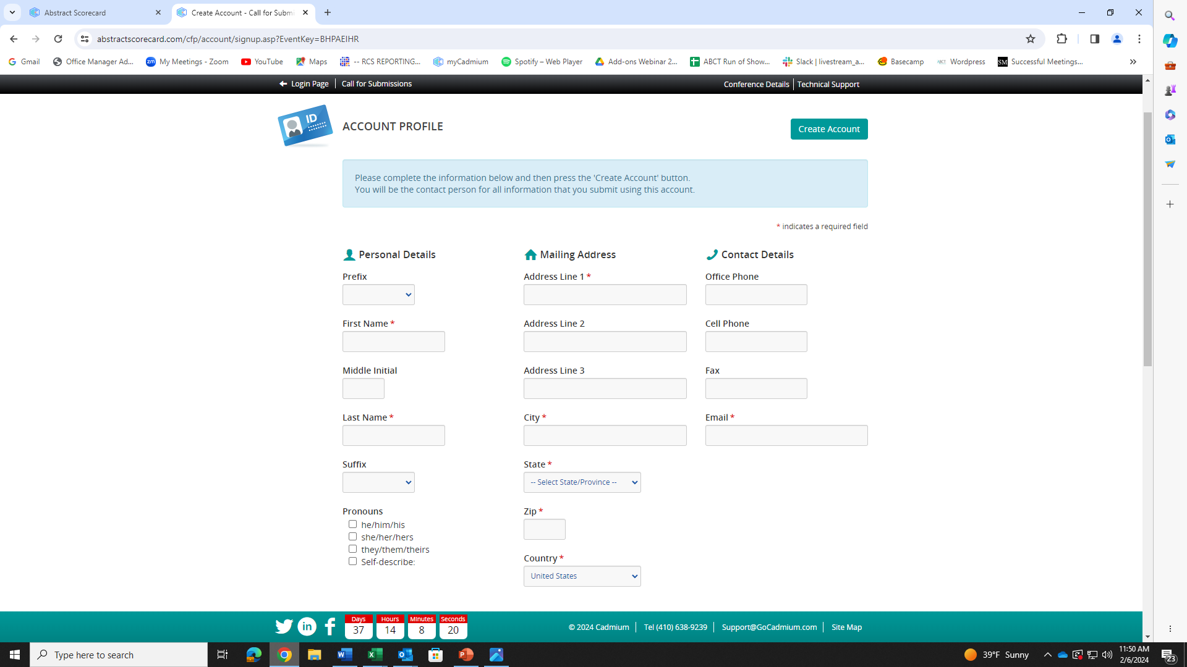
Home Page for Submission Center
Once you click “ Join Now”, you will be directed toward this page, where you must create a profile and access key (password) to continue.

Slide 3
Once you create your account, you will then be directed to a privacy agreement which you will have to virtually agree to and sign.

Slide 4
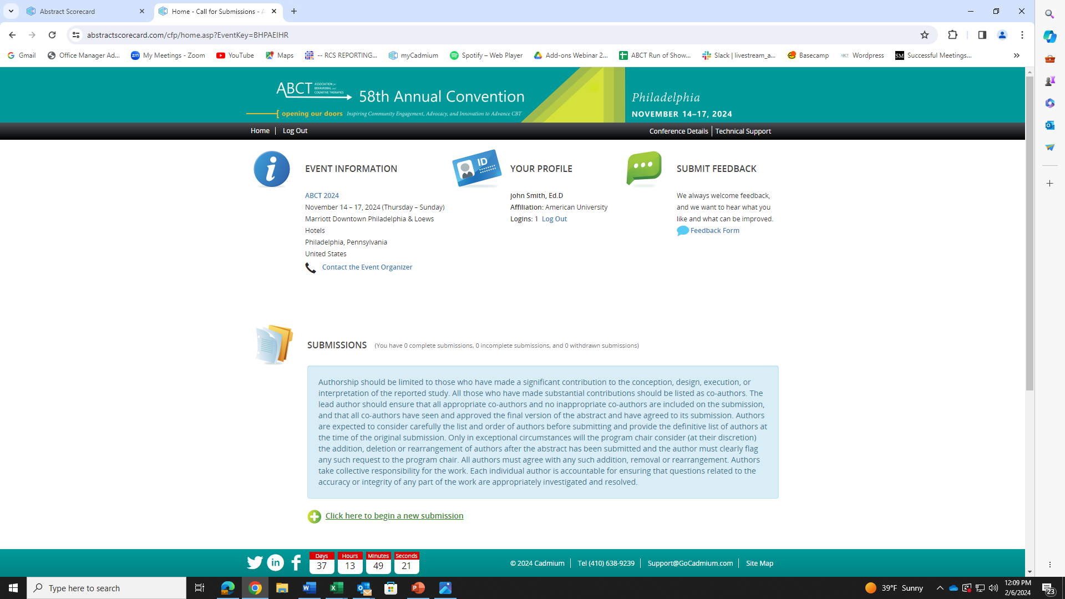
Start a New Submission and Task
After you e-sign your privacy agreement, you will be directed here to begin your new submission. Click + sign to begin a new submission.
TIP: If you need to exit your submission and return to complete it later, remember to click Save.

Slide 5
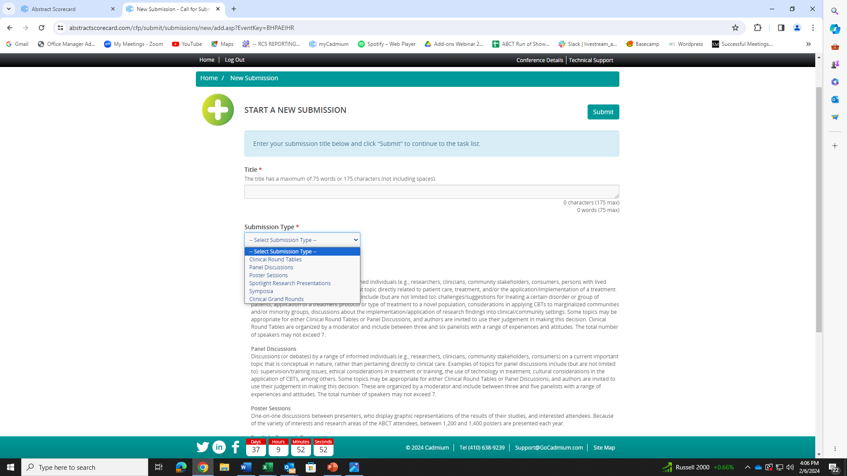
When you begin a new submission, you will be asked to fill out new information about your abstract. You will see a series of “fill-in-the-blank” options as well as drop-list options to choose selections from, like shown here. On this page, you will be asked to title you submission type. Below the drop-down list, there is a description of each submission type to help guide you.
When you have selected, please click “Submit”.
Each submission type has different field requirements, so once you choose a type, you cannot modify it.
You must create a new submission to choose a different submission type.

Slide 6
Once you submit your title and submission type, you will be directed to this page. On this page you will see 8 numbered selections that you must click on to continue moving forward. Begin with selection One (1) by clicking on the blue lettering Panelists.

Slide 7
Task List #1: Presenters/Authors
TIP: The presenter (s)/author(s) that you add within this task will be carried over to the individual abstract task (see below). Please only enter Authors here that will serve as Chair, Discussant, and/or Presenter and will be attending the conference and actively presenting. Co-authors for the individual abstracts who are not presenting should be entered through the “Individual Abstracts” section.
You will then be directed to this page, which allows you to add panelists. You must add one panelist. When you fill out the information, click “Add Panelist” then scroll down.
Once you reach this page you will need to add a panelist. You must add at least 1, but no more than 7, panelists. You also must have 1-2
moderators.

Slide 8
Information Required for Authors
Title
Keywords (at least three)
Author Information
First & Last Name
Email
Affiliation
Credentials/degrees
Role (Moderator, Presenter)
Membership Status
When you scroll down you will see your added panelist listed below. You can then invite that panelist to remove or edit the profile.
You will need to edit the profile information to complete it. You can see where it says “Profile Incomplete” below the panelist’s name and position. You must click “Edit Profile” before you are able to move forward by saving the panelists.
Note: Please “invite” panelists to edit their own profile. See the green button next to “Edit Profile” option below your additional panelist. This “invite” button will generate a unique email to the panelist with instructions and a link to finalize their profile.

Slide 9
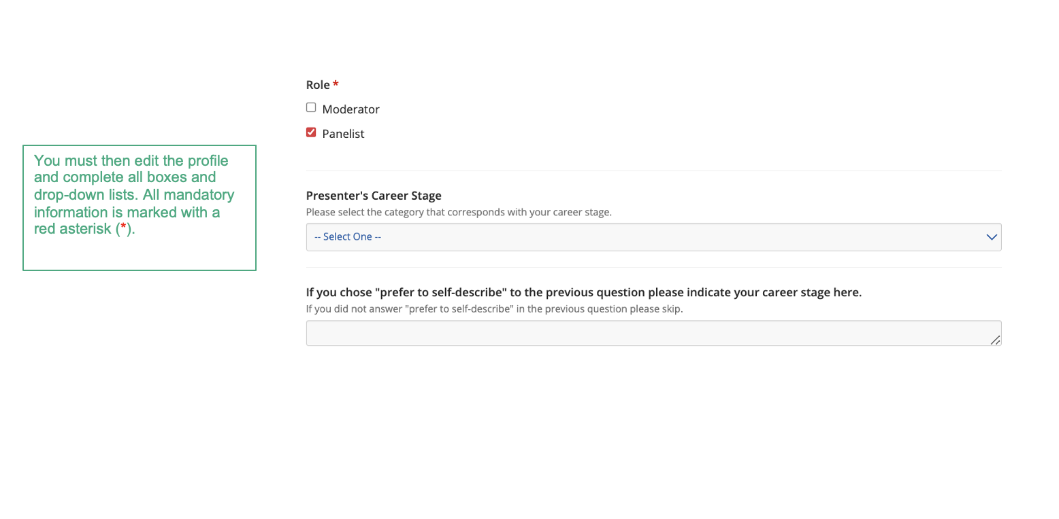

Slide 10
Individual Abstracts and How to Request Information From Collaborating Presenters
Note: If you choose to “invite” individual Panelists or Co-authors to edit their profile, make sure their e-mail is correct and click the green “invite” button as noted in the slide.
Your co-author/panelist will receive an email like this requesting that they take action to complete the information required. They must click “Click here to log in to the Call for Submissions system at any time to complete this task.” to follow the link to complete the required information.

Slide 11
Information Required:
Title
Keywords (at least 1, up to 3)
Abstract: 2200 characters
List of co-authors
First & Last Name
Credentials
Email
Title
Organization/Affiliation
You or your panelist must edit the profile to contain all required information. All required information will have a red (*) next to it.

Slide 12
Once the required profile information has been entered, you or your panelist will affirm that all authors have agreed and approved of the abstract and official author order.

Slide 13
Further Clarification for Gathering of Submission Information
As the initial presenter submitting this form, you do not need to have all the information for your co-presenters!
It would make most sense for the CHAIR of a symposium to enter in all the general information and the presenter information. Then, the symposium Chair can prompt co-presenters to log into the system and complete their sections.
This removes the burden from the Chair for having all the necessary and personal information from colleagues and allows each presenter to sign their disclosure forms and complete background questions in a private manner.

Slide 14
Task List #2: Overall Abstract and Details
Tips:
The title should be entered in mixed case, NOT all capital letters.
If you copy and paste the title and/or body from your word processor, special characters should transfer, but formatting (e.g., underlining or bolding) will not transfer. You can insert special characters and/or formatting tags using the character palette. To access the palette, click on the “Special Characters” button located on the Title/Body page.
Abstract Body CHARACTER LIMITS:
Symposia:
2800 characters for summary abstract
2200 for individual presentation abstracts
Research Spotlight Presentations, Panel Discussions, and Clinical Round Tables:
1950 characters
Poster Sessions
2800 characters

Slide 15
Task List #3: Learning Objectives
Tips:
3 Learning Objectives and 2 long term goals are required (you may submit up to 5 learning objectives total)
2. Should be written in present tense.
Please write from the perspective of
the audience:
At the end of this session, the learner will be able to….

Slide 16
Task List #4: Speaker Release Form
Every author should complete this form independently. Click on Speaker Release Form in the blue box to download. Upload signed and dated release form in gray box on page .
* Please do not complete this form for other authors.
SPEAKER RELEASE FORM
This Speaker Release is provided to the Association for Behavioral and Cognitive Therapies (ABCT) with respect to the following presentation (the “Presentation”):
Presentation Information
Title of presentation:
Name of event: ABCT 58th Annual Convention
Speaker names:
Dates of event: Thursday, November 14- Sunday, November 17, 2024
By signing below, I grant ABCT permission, free of charge and without limitation, to photograph, record, publish, or otherwise copy such Presentation. I further grant ABCT a royalty-free and unlimited license to broadcast, display, reproduce, edit, exhibit and distribute the Presentation and any derivative works created from or with it, over television, cable, the Internet, by creating CDs or DVDs or by any other communication medium. ABCT also retains the right, at its sole discretion, to choose whether to archive the footage, and whether to use it for any other purpose. The authorization explicitly includes the use of my name, likeness, voice and/or pre-approved biographical information for the purpose of publicizing any broadcast, webcast, distribution, publication, or exhibition of the specified program or portions thereof. ABCT, by capturing the Presentation (“Recording”), will become the copyright owner of that Recording. To the extent that I have any rights in the Recording, I hereby assign all rights, title and interest in the Recording to ABCT. The Presentation and any Presentation materials are my own original material or material for which I have full authority to grant the rights set forth in this Speaker Release. This Speaker Release supersedes all prior agreements pertaining to its subject matter and can only be amended by written agreement with ABCT.

Slide 17
Supplementary Information: Task List #5
Please complete all areas of instructed information on this page.

Slide 18
Task List #6: SIG Sponsorship
If a special interest group has agreed to officially sponsor this submission, please complete this section.

Slide 19
Task List #7: Financial Disclosure Form
Each presenter will need to log in and complete the financial disclosure form. When the primary/initial presenter completes the submission, they will be able to send the previously shown email prompt to other presenters through Cadmium so they can log in and complete this step.

Slide 20
Task List #8: Child Care Please select from the drop-down menu whether you will be utilizing the Child Care services at the convention.

Slide 21
Completing the Task List
Note: When your task list is complete, all 8 tasks will have a green check mark next to the number.

Slide 22
Once you are done, review and submit the proposal.
You will receive an email confirmation that looks like this:
Call for Submissions: ABCT 2024 You can access your Submission at any time by clicking here. Submission Type Clinical Round Tables Submission Status: Complete Submission ID: 1739577 Submission Title: Research Panel Presenter(s) Test R. Tester, M.D. (he/him/his) (Role: Moderator) Paul Lynde, Psy.D. (he/him/his) (Role: Presenter) Elizabeth Montgomery, ABPP, MSW (she/her/hers) (Role: Moderator) Overall Abstract and Details Category 1st choice: Anger

Slide 24
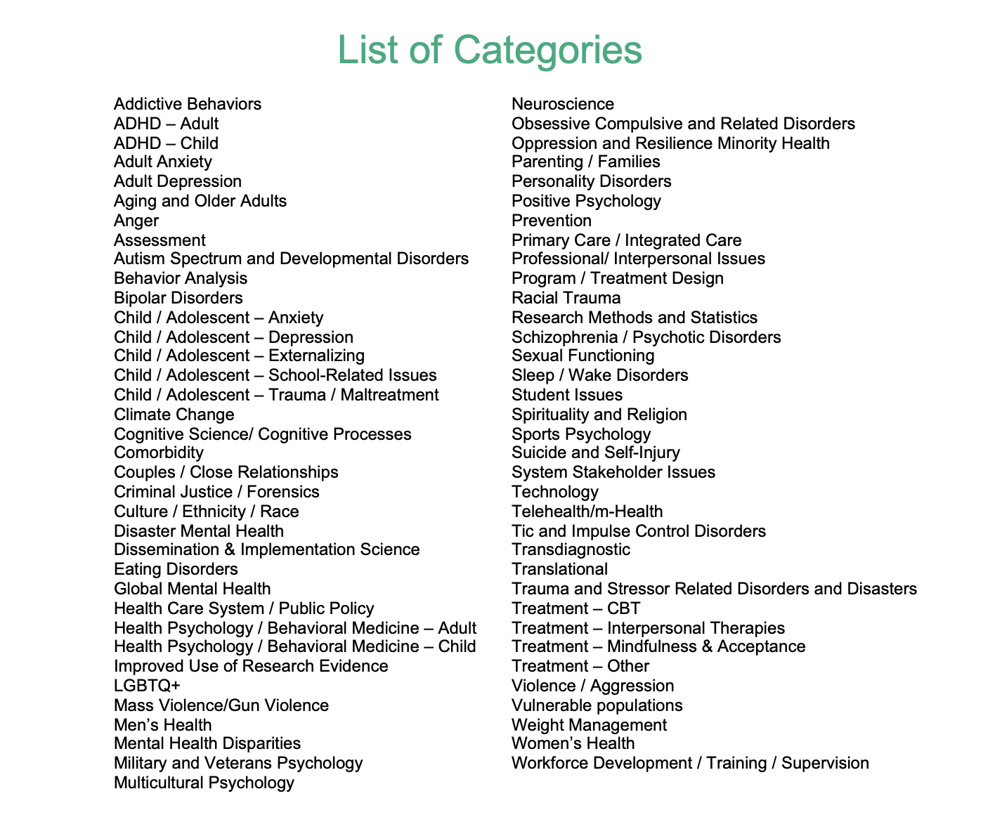

Slide 25
